Slide 1
Advanced Stuff
Michael Yarichuk
Hibernating rhinos
michael.yarichuk@hibernatingrhinos.com

Slide 2
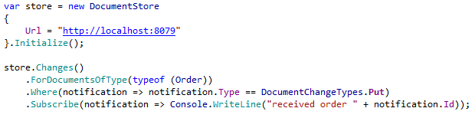
Changes API
Notes:
Self explanatory…

Slide 3
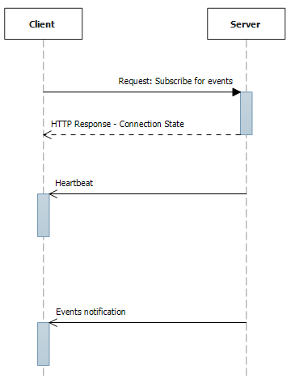
Changes API
Notes:
Subscription for events
Opened connection, HTTP stream

Slide 4
Facet Queries
Special type of query
Aggregate by ranges
Reporting in RavenDB?
Notes:
Фасетная классификация → отнесение объекта к разным категориям (задание множества и его элементов).
Facets → сортировка по категориям или по диапазонам внутри категории

Slide 5
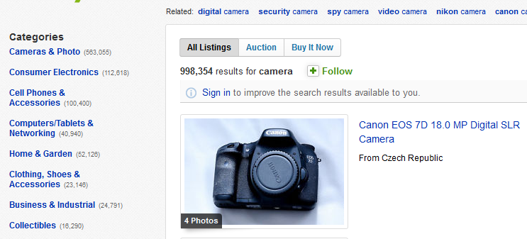
Facets

Slide 6
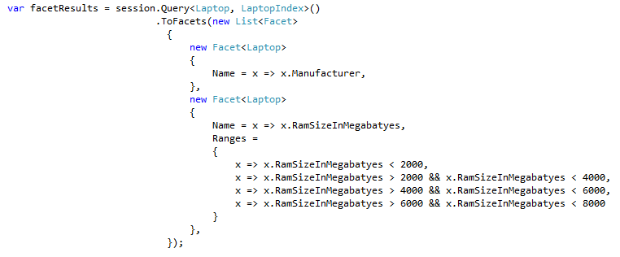
Facets

Slide 7
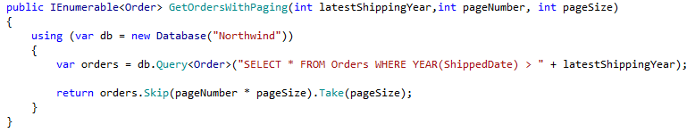
Streaming API
Common gotcha – unbounded results

Slide 8
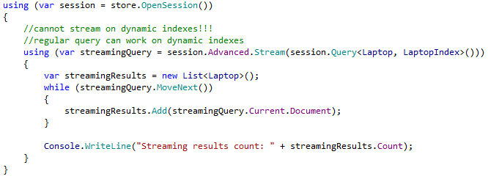
Streaming API
Solution with RavenDB API
Notes:
Do not forget to mention that streaming WILL NOT work on dynamic indexes → explicit index must be defined for streaming!

Slide 9

Bulk Insert
Notes:
Optimized inserts – much faster
Consistency – per bach size → default is 512
No notifications in Changes API

